Slide 1
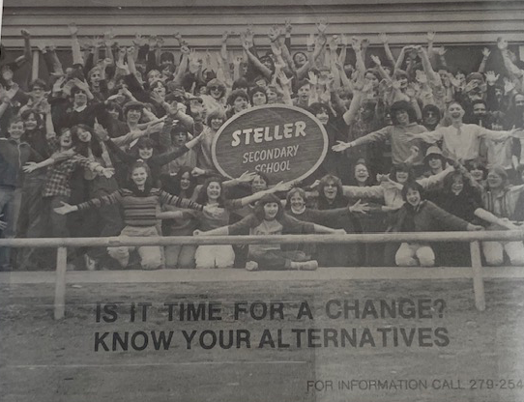
FACT SHARING PARENT FORUM
September 21st, 2023
Notes:
NOTE:
To change the image on this slide, select the picture and delete it. Then click the Pictures icon in the placeholder to insert your own image.

Slide 2
Land Acknowledgement
We acknowledge that we gather here today on the traditional lands of the Dena'ina People of Upper Cook Inlet. For thousands of years, the Dena'ina People have been and continue to be the stewards of this land. ASD is committed to diversity and inclusion, and it is with honor and respect that we recognize all Indigenous people who live and learn in our community. Thank you very much.

Slide 3
AGENDA 9.21.23
Steller past & present
6th grade to Middle School
College, Career, Life Ready (Kersten Johnson)
School Start Times
Next Steps:
9/25/23- Students will discuss in Advisory
10/03/23 – Staff will continue discussion during PLC time
10/10/23 – SPG will introduce discussion during the SPG October mtg.
10/16/23 – SPG will lead discussion over Zoom 7:00-8:30pm
10/19/23 – SPG will lead discussion in person 6:00-7:30pm in person at Steller
11/2/23 – All community meeting – It is essential you attend this meeting as we will vote on a proposal to bring forward to ASD administration.
ASD Website – Hot Topics: https://www.asdk12.org/HotTopics
Notes:
We will not have final say ONLY proposal CHECK OUT THE LINK

Slide 4
STELLER PHILOSOPHY
Steller is a school devoted to an educational setting which fosters the creation of independent, courageous people capable of dealing with the shifting complexities of the modern world. It runs on the energy and excitement of people who have committed themselves to self-directed learning. With the support of parents and staff, it attempts to help provide students with a humane education based upon freedom and responsibility.
The underlying idea of the school is that responsible freedom is a supreme good; people, including young people, have a right to this freedom. People who are encouraged to pursue their own path will, in general, be more open, more humane, more knowledgeable than people who are directed, manipulated, and ordered about.
We believe that every student should be free to establish his or her own path to becoming a more fully self-sufficient person. We recognize that this search takes place in the context of an interdependent world, and that part of this quest involves the recognition of each individual’s role/responsibility in the larger community.
Students are responsible; to the extent each is capable, for defining their own educational goals, selecting or devising a course of study to achieve these goals, and working to fulfill these goals. They are also responsible for assisting in the continuous evaluation of their performance in relation to these same goals.

Slide 5
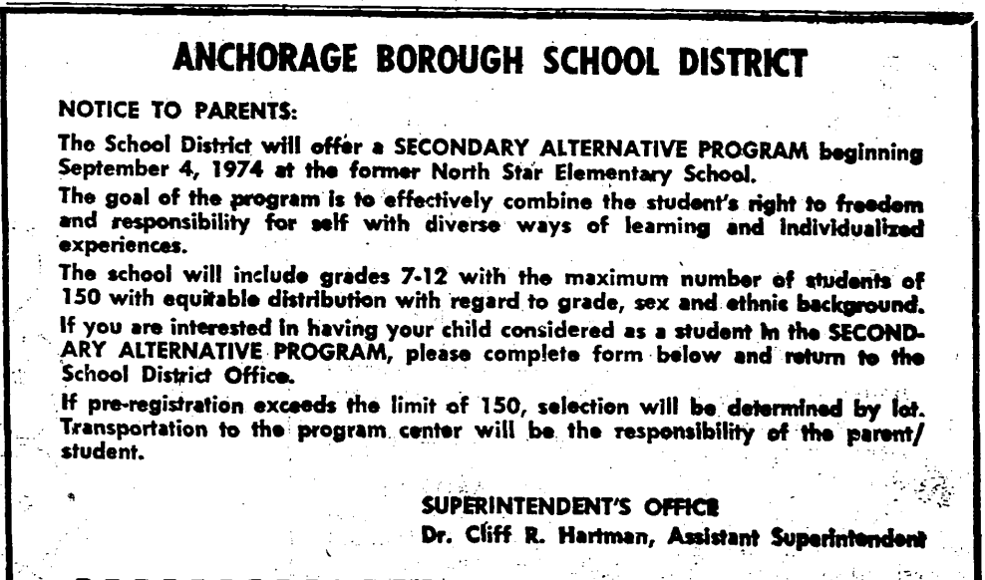
Steller’s opening- September 4th, 1974

Slide 6
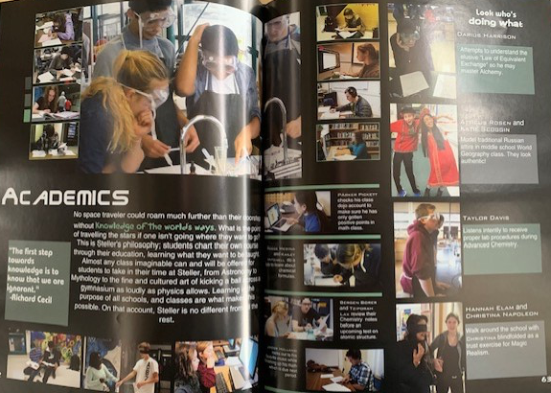
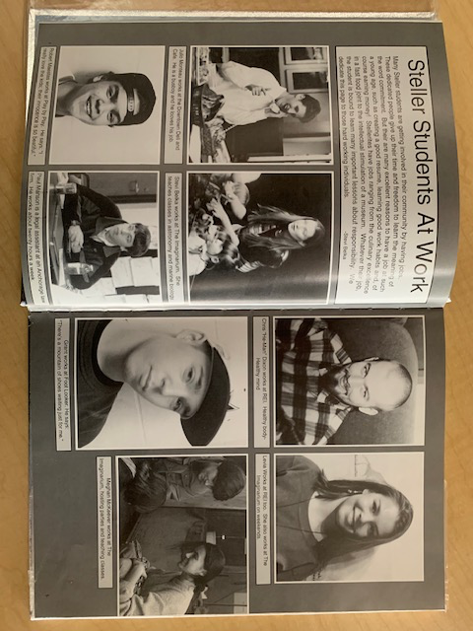
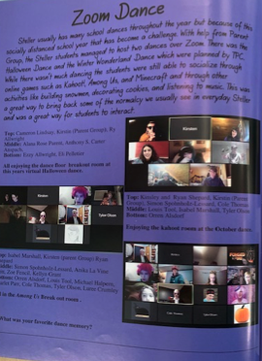
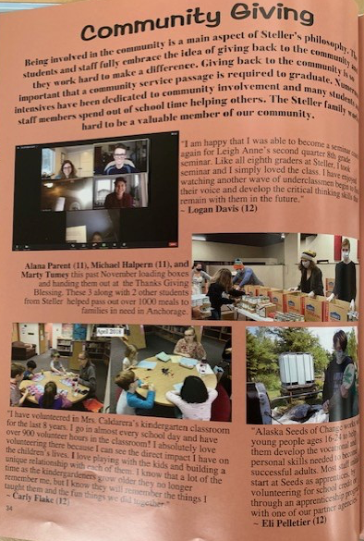
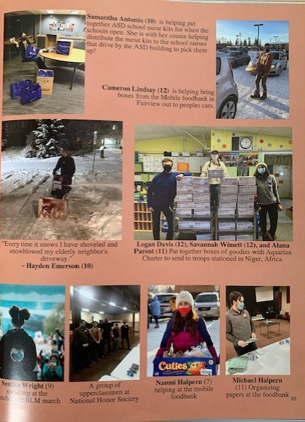
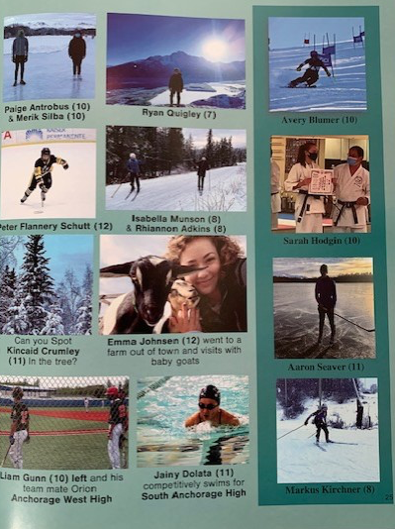
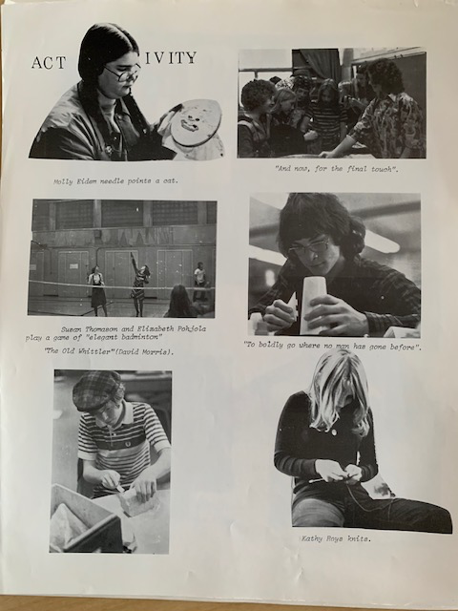
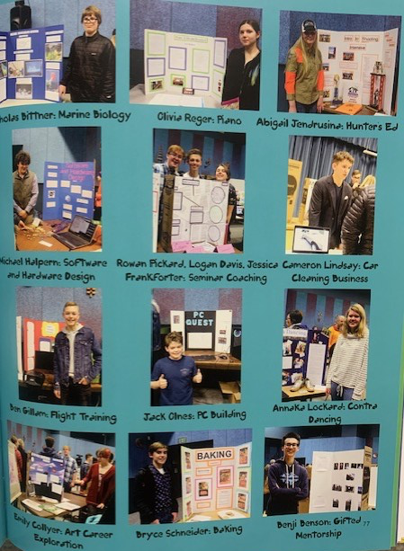
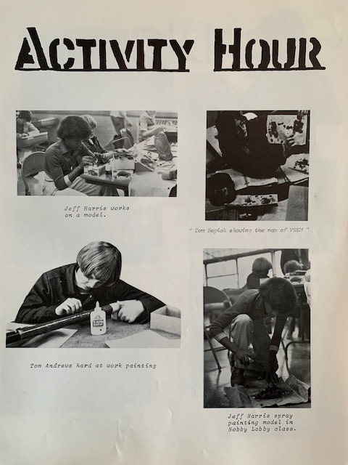
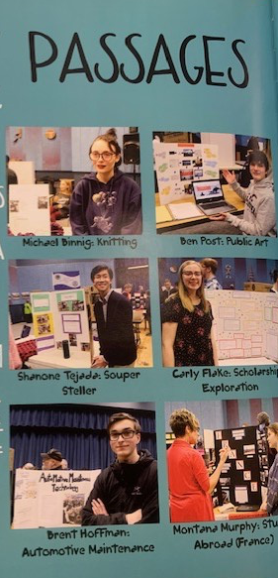

Slide 7
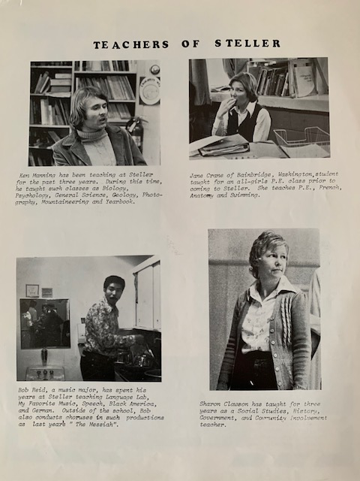
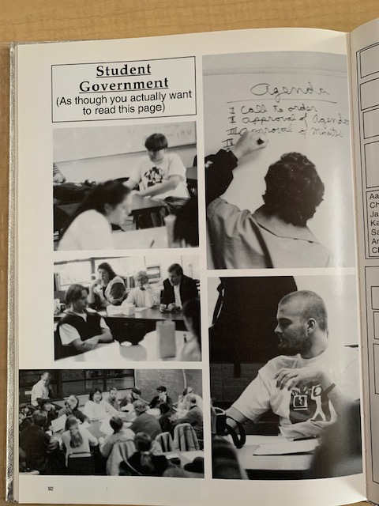
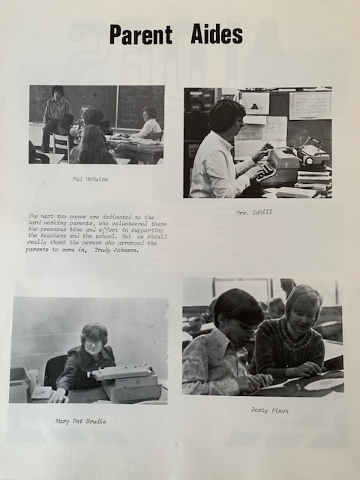
STELLER – 3 pillars

Slide 8
Steller today
252 seventh-twelfth grade students
100% graduation rate in 2023
15% of our students in the Class of 2023 received the Seal of Biliteracy
Multi-age classes and advisory groups
Student-led school governance
Peer-taught electives developed by students
Self-directed learning and Independent study courses
2-week single-topic intensive course
Passage courses designed by students
Over 1,500 hours of community service every year

Slide 9
Future of Steller
6th grade to Middle School
College Career Life Ready
School Start Times

Slide 10
ASD Impacts - 6th grade to Middle School
Benefits
Challenges
Increased elective / exploratory opportunities:
Band, orchestra or choir are offered daily
CTE course offerings available
World language electives available
Increased daily instruction in Social Studies & Science
Availability of higher-level math (i.e., Algebra & Geometry)
Standardize 6th Grade instruction
Daily PE classes and participation in sports and activities
Significantly larger middle level faculties & associated improvements in level of service to students in all needs categories
Some faculty members and community members will be hesitant to change
Elementary schools will have lower overall enrollment; potential changes to current feeder boundaries might be appropriate
Classroom & instructional area needs exist at some schools; the District may need to add relocatables or share classrooms when feasible
More support personnel (clerical, security, counselors) will be needed at some sites as enrollment increases

Slide 11
College, Career, and Life Ready!
Kersten Johnson – Senior Director of Teaching & Learning, Secondary
Devon Roberts – Assistant Director of Career and Technical Education

Slide 12
What is the Mission of College, Career, and Life Ready?
More than a diploma -a launchpad for life!
Grad Requirements +
Career Pathway to Engage
Community Connections
Strong Workplace Skills
Graduating our students College, Career, and Life Ready!
Notes:
Creating the CCL goal was an important step in recognizing that our community wanted a priority placed on preparing students for more than just a diploma. The CCL goal recognizes life after high school is more complex today than it was 20 or 30 years ago. The options available to students today are different and we need to provide the opportunities for all students to prepare for this critical transition into adulthood.
The mission of College, Career and Life Ready is to provide students with a launchpad for life.

Slide 13
The Why
ASD
Stagnant Grad rates
Poor attendance rate
Suspension rates increase
Mental health needs increase
Lack of engagement and connection in students
ANCHORAGE
Decrease in Workforce
High Outmigration
Low Birth Rates

Slide 14
Notes:
ASD began envisioning what this “LAUNCH PAD could look like. We looked within our schools to identify the programs that facilitate the development of students' workplace and technical skills and provide them with perspective on life beyond high school. We also looked models outside of ALASKA. After due diligence, ASD is boldly implementing Wall to Wall Career Academies by the fall of 2025. With a student body of 12,000 young adults under our care, our aim is to enhance their readiness in becoming not only well-rounded, happy and healthy community members in Alaska, but also to contribute to the growth of Anchorage's workforce pipeline.
WHAT IS A WALL TO WALL CAREER ACADEMY?
A career academy is a specialized educational model within a high school that offers students focused technical training and learning experiences in a specific career pathway. It aims to prepare students for future careers by providing practical skills, industry knowledge, and real-world connections in their chosen field. Currently we do this in small pockets ASD. Wall to Wall means that every student, regardless of their background and achievement level will have the opportunity to participate in Career Technical courses with intentional ON RAMPS at all Level and explore their passions and potential. Additionally Exposing students to career pathways they may not be familiar with at home expands their horizons, broadens their options, and helps them discover interests and talents they might not have otherwise realized. "You cannot dream what you cannot see". This is the CRUCIAL equity component that propels social mobility of young adults. TO Move Forward: ASD will need to shift in three distinct ways: HUGE EXPANSION Career Technical Courses for EVERY student. Creation of Smaller Learning Communities based on Career Interest And COMMUNITY MINDED APPROACH

Slide 15
Notes:
Lets Dive into what these Academy Teams will look like for students. Within every Academy Pathway, the structure of coursework is the same. A career technical course is coupled with the traditional core classes of Math, Science, Language Arts, and SS for each student. Its the a driving force, It is the essential 5th core that GUIDES and CONNECTS everything together. It’s the Relevance added to the Rigor. For example, a student in a Construction related pathway may pair their Geometry class, with a Geometry in Construction CTE course where they can also earn an OSHA-10 certification thus providing context to their learning AND industry recognized certifications. During their Junior and Senior year, students will continue to advance in their career technical training; in this instance; options may include Blueprint Reading and Design or Electrical and Plumbing Basics . The ultimate goal is to provide capstone experiences such as job shadowing and internships for students who are ready to take the next step. Secondly: The Career Academy Team Structure creates a small community within our large comprehensive high schools. The team is comprised of students of similar interests and teachers teaching through the lens of the specific career pathway. In this model, Students have a better chance to connect with their teachers and likeminded students. Finally, every Academy Team Structure, contains a network of community members, employers, postsecondary partners, such as yourselves, to support student learning by providing insight to guide student learning to ensure its relevance, by creating opportunties for work-based learning from guest speakers to job shawdows and student internships and teacher externships. In the end, these students will become your workforce, creating these connections and relationships will lead to students who are better prepared for your future jobs and the connections you make now will help fulfill your workforce demands. This community-connected approach supports a smoother transition beyond a diploma for our students and also contributes to retaining our youth within the state.

Slide 16
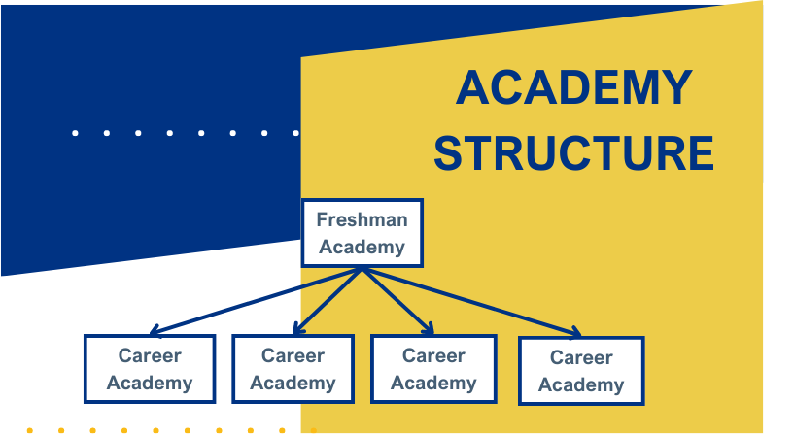
Notes:
Let’s pretend this is one of our 8 comprehensive high schools: To begin Freshman Academy will be home to all of are incoming freshman students. The academy structure allows the opportunity to create a small school feeling within a large school, while setting the foundation for a successful transition. Freshman Academy also provides guaranteed experiences for everyone student as we know. all students do not come to the table with a full plate of experiences and opportunities due to circumstances out of their control . Key aspects of the Freshman experience include: Common Expectations, A Freshman Seminar class to help them students identify meaningful workplace skills and understand how their unique gifts and passions fit with real careers. A Career Exploration Fair where students learn about a variety of careers within industrys in Alaska while talking with local professionals about their interests. Finally, in the spring, the freshman will choose their Freshman Academy based on the knowledge they have learned in the Freshman Academy. Once they have chosen their Academy, they will choose a Career Pathway within their Academy: As an example: One of these academies may be the Academy of Applied Technology; students may have the option to choose from a range of pathways from Engineering and Design, Automotive Technology and Construction and Trades. Another Academy may be a Medical Academy with pathways in Biomedical Sciences, Pharm Tech and Medical Assisting. The big question remains..who decides what Academies are needed in Anchorage? Plain and simple. Workforce data and we want you to be a part of it. There is no sense to build a comprehensive system that does not lead to high skill, high wage professions.

Slide 17
Notes:
Kersten

Slide 18
Growing Work-Based Learning
Expand our current footprint through powerful partnerships
Build a system for more granular tracking of WBL data
Deepen work on the WBL continuum

Slide 19
Deepen WBL Experiences for Students

Slide 20
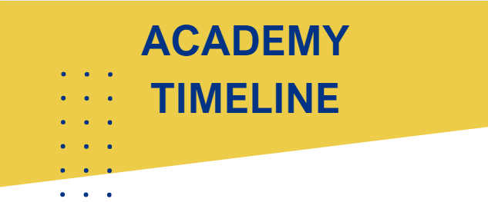
Notes:
Kersten

Slide 21
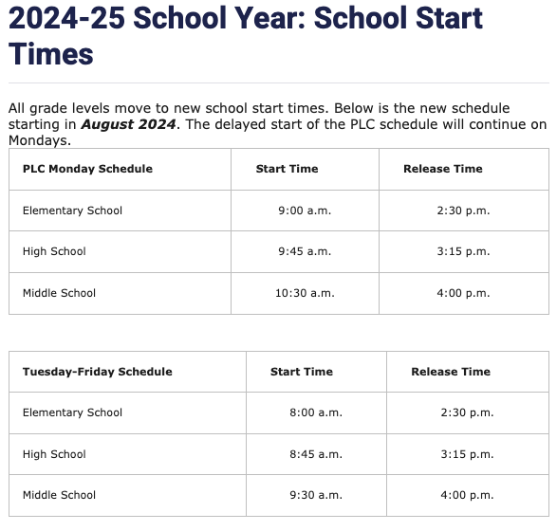
School Start Times

Slide 22
Things to know and ponder:
We must make a proposal as to whether we would like to be a 6th-12th or 9th-12th grade program and whether we would like to implement CCL academies
We currently have 252 but our Steller capacity is 300
59- 7th graders, 34- 8th graders, 54-9th graders, 48- 10th graders, 41-11th graders, 16-12th graders
We have 11 core teachers, 1 world language teacher, 2 fine arts teacher, 1 special education teacher
Our recruitment efforts will have to adapt to the program we choose
Our current schedule will have to adapt to the program we choose while meeting the ASD and state requirements and curriculum standards for Middle School and/or High School
Across the district all 6th graders will be moved to Middle Schools
Most ASD schools with the exception of a few charter and alternative schools do PLCs on Monday
All ”Big 8” high schools will implement College, Career, Life ready
School start times will start during the 24/25 school year
There is no financial advantage to Steller for either 6th-12th or 9th-12th, enrollment drives budget we can enroll 300 students.
If Steller were to become 9th-12th it will be a three-year process. Meaning our current 7th & 8th graders will continue to attend Steller until 12th grade year. We will start recruit more 9th-12th graders for the coming school year.
If Steller were to become a 6th-12th program, we will start recruiting 6th graders for the coming school year.

Slide 23
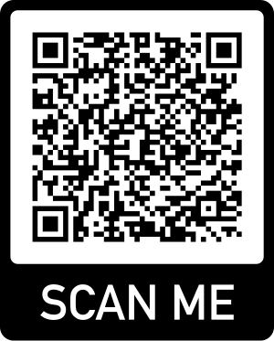
Next Steps
Check out ASD Website – https://www.asdk12.org/HotTopics
Fill out our first Q&A – QR codes are around the room
Participate in one of the following discussions:
9/25/23- Students will discuss in Advisory
10/10/23 – SPG will lead discussion during SPG October mtg.
10/16/23 – SPG will lead discussion over Zoom 7:00-8:30pm
10/19/23 – SPG will lead discussion in person 6:00-7:30pm in person at Steller
Come to the 11/2/23 – All community meeting – It is essential you attend this meeting as we will vote on a proposal to bring forward to ASD administration.
A quorum for the Steller community will consist of a number equal to or greater than 30% AND 15% of those attending must be students.
We need 75 people to make quorum, 12 must be students.
Talk to your children and other family members.
Help us be creative and as our philosophy states: “we are independent, courageous people that are capable with dealing with the shifting complexities of the modern world”.

Slide 24
THANK YOU

